Slide 1
Technology for Deaf and Hard-Of-Hearing
Raja Kushalnagar, J.D., LL.M., Ph.D.
Gallaudet University

Slide 2
Diversity of Experience = Diversity of Opinion
Deaf and hard of hearing (DHH) people’s needs are very diverse!
What works for one person may not work for others
DHH people want flexibility and a wide array of information and communication strategies.

Slide 3
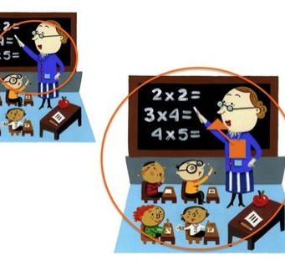
Visual Perception
Aural Perception: A bubble
Perception is inversely squared: Doubling distance reduces volume by 4

Slide 4
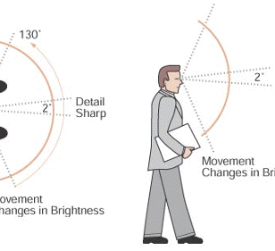
Aural perception
Visual Perception: A slice
Perception is linear: Doubling distance reduces acuity by 2 (linear)

Slide 5
What’s going on? Hard of Hearing Experience
Wants pawn term, dare worsted ladle gull hoe lift wetter murder inner ladle cordage, honor itch offer lodge dock florist. Disk ladle gull orphan worry ladle cluck wetter putty ladle rat hut, an fur disk raisin pimple colder Ladle Rat Rotten Hut.
Once upon a time, there was a little girl who lived with her mother in a little cottage on the edge of a large dark forest. This little girl often wore a little cloak with a pretty little red hat, and for this reason people called her Little Red Riding Hood.
Notes:
This story, believe it or not, is the very familiar fable of Little Red Riding Hood. H. L. Chace, a professor of French, wrote this in 1940, to show that intonation - that is, the melody of a language, matters.
“It is hard to explain to others what it is like to be hard of hearing — the lack of clarity in speech, the sensitivity to loud noise, and the exhaustion that comes with heavy bursts of communication. It is an invisible disability so it is often misunderstood, downplayed or even ignored —”
-Sheri Ebert

Slide 6
Information and Communication Accessibility
Everything else constant, communication is maximized when:
audio-visual presentation is optimized for the individual
Notes:
Information and communication are multimodal.

Slide 7
TEXT

Slide 8
ASL

Slide 9
Visual Noise
Notes:
Dispersion
Luminance
Distance

Slide 10
Accommodations for Visual Noise
Reserve seats with clear lines of view (often front seats)
1
Avoid blocking visuals
2
Do not dim around visuals
3

Slide 11
Diversity and Disability in Engineering/Technology
“I believe that engineering is a highly creative profession. Research tells us that creativity does not spring from nothing; it is grounded in our life experiences, and hence limited by those experiences.
Lacking diversity on an engineering team, we limit the set of solutions that will be considered and we may not find the best, the elegant solution.”
William A. Wulf, 2000, National Academy of Engineering President
Notes:
Diversity and inclusion is a recent development.
Universal Design - a product is accessible by all - has gained prominence. Inclusive design - which embodies the concept of deaf gain - is about the process through which you arrive at the accessible product: a diversity of perspectives, including diversity of disabilities - are involved from the beginning. And this results in better products for EVERYONE. We will talk about three examples next - with strong Deaf and Gallaudet leadership
Many deaf gains and access since then.

Slide 13
Captions
 | % using captions
Deaf | 96
H of H | 97
ESL | 89
Hearing | 20
Everyone loves them
Gen Z demands them
About 30% of viewers now use captions (USA, UK, AUS surveys)
85% of Facebook video views have no sound
Browsers mute auto-playing videos by default
All Students like and benefit from captions (US academic survey)
Notes:
Starting with the dream of a Deaf person - Emil Ladner. Initially there was a lot of resistance to captions. There has been a sea change. Generation Z and Senior Citizens demand and benefit from captions, and many others. (show examples in left column)
Now the focus is shifting to how we make captions better for all of us - this is driven by deaf needs, and current research at Gallaudet. (switch to right column)

Slide 14
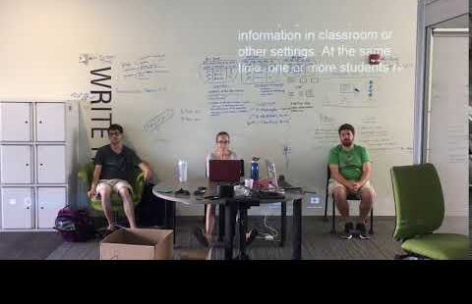
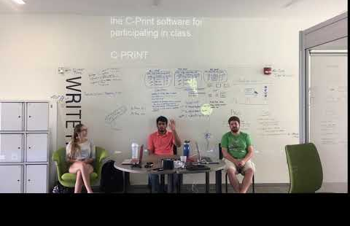
Caption Reading Diversity
A caption reader’s experiences in following captions is grounded in the reader’s life experiences, and hence limited by those experiences.
Most captions limit the set of solutions that will be considered and may miss out on presenting optimal, elegant solutions.

Slide 15
What can you do? DHH user-centered Technology Innovation
DHH as participants/innovators
NOT passive recipients
System support matters!
User Centered Design
Analysis by Users
Design by Users
Prototype by Users
User Feedback
Notes:
Access and innovation will not scale up if too few technical innovators with diverse abilities
Lead & participate both - this embodies inclusive design

