Slide 1
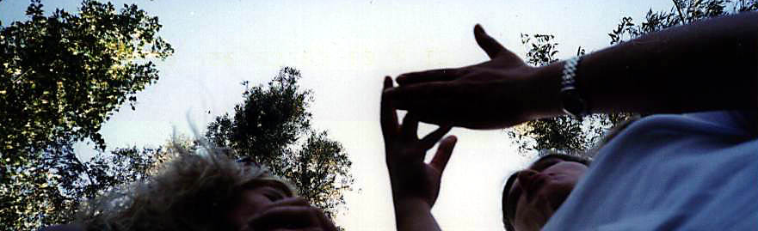
THE FUTURE IS IN OUR HANDS!: Recognizing the right to Sign Languages
Pamela Molina
Executive Director – World Federation of the Deaf

Slide 2
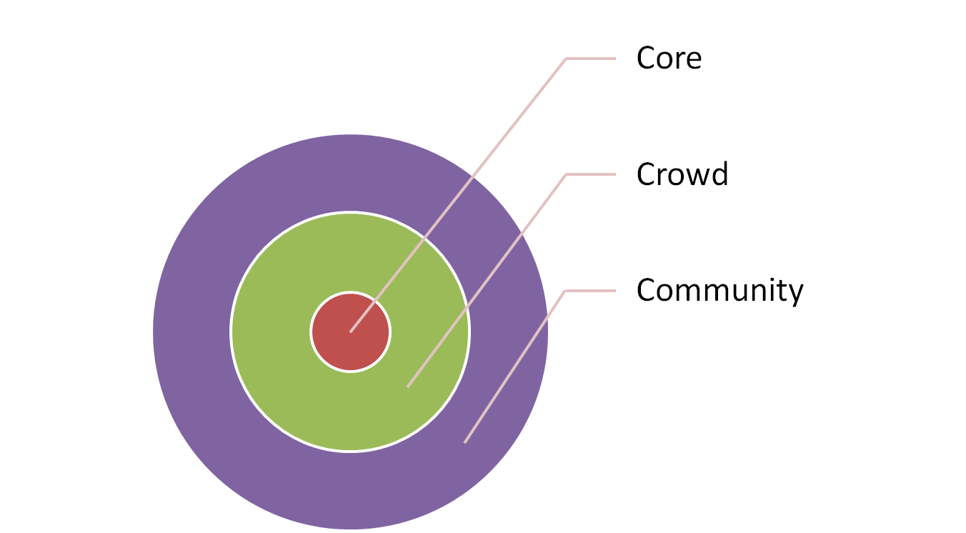
Biases and its implications
How many identities do we have in this session?
Trust Circle

Slide 3
INTERSECTIONAL DISCRIMINATION
”ISMS”: IDEOLOGICAL – CULTURAL OPPRESSIONS
Racism
Heterosexism
Normocentrism
Ableism
Audism
Male Chauvinism
Ageism
Etc…
A single logic, and intersectional discrimination
Mitigating the impact of unconscious biases is critical for a culture of inclusión.

Slide 4
INTERSECTIONALITY AND
HUMAN RIGHTS
Human Rights treaties must be complied with, interpreted and monitored in a transversal, intersectional and differential focus.

Slide 5
Deaf People: Intersectional Identity
Deaf community
Part of disability movement
Linguistic and cultural group

Slide 6
Deaf People: Intersectional Identity
Language
A means for access to rights
A human right itself (collective)

Slide 7
Audism example: Language deprivation
The brain forms 700 new neural connections every second from the age of 0-5 years. Language deprivation is the lack of access to language structure in a period of meaningful learning.
Sign language is the only language deaf children can learn effortlessly and do not require any additional support.
Early acquisition of sign language is essential for overall language development and provide support for deaf children’s linguistic competencies.
Approximately 90 to 95 percent of deaf childhood is born to hearing parents, who often do not know or learn sign language.
Only 5% of deaf children are born from deaf parents or parents using sign language.
Late exposure to a language negatively affects its proficiency and, therefore, the exercise of all other human rights.

Slide 8
Only 2% of the world's Deaf population has access to sign language education.
(UNESCO: The right to be educated in our own natural language)

Slide 9
The collective dimension of deaf people’s rights
National laws and policies fail to recognize the collective dimension of the right to sign language by providing ocassional SL interpretation without guaranteeing the building of language concordant environments in all areas of social and citizen life, or when they conceive sign language merely as a "communicative tool", thus nullifying its character as a vehicle for transmitting culture and identity:
Protecting sign language only as an alternative measure of accessibility or individual reasonable accommodation often leads to the reduction or omission of linguistic rights as collective and cultural rights. Thus, by ignoring their collective dimension, laws and policies contribute, paradoxically, to language deprivation for deaf people, with serious consequences on their human, social and political development.

Slide 10
“DEAFHOOD”
Linguistic-Cultural Model: eliminates the concept of "deficiency" as the basis for defining the disabling of divergent bodies and ways of functioning.
There is a parallel identity that is constructed as a process: deafhood. Deafhood is an identity defined by an eminently visual way of unfolding and understanding the world, which is perfect and complete as it is, and which has no relation to the auditory. It is not a fixed concept. This term has nothing to do with the absence of sound, the "hearing impairment", or the lack of something, and therefore is different from "deafness".
The omission of this intersection in laws and public policies aggravates the exclusion experienced by deaf people since they perpetuate an" audist" ideology that requires them to adapt to a social structure, a language and an identity based on a hearing view.
Laws and public policies omit the existence of a essentially visual community, with a diverse language and representation of the world coexisting within the hegemonic society, which has been and continues to be a victim of cultural and linguistic colonialism.

Slide 11
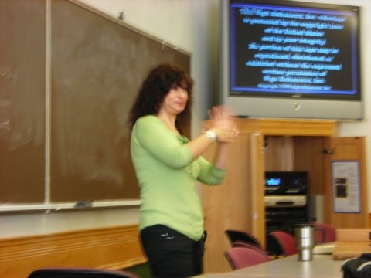
Audism examples: cultural colonialism
“Why you don’t have a Universal Sign Language”?
“This event includes International Sign Language Interpretation” (GDS 2022!)
“No worries about SLI, we will meet on google meet”!.
“We have closed captions, no need for SLI”.
"Rehabilitation" based on "auditory normalization" and not on the promotion of linguistic-cultural autonomy and independent living.
It is hour of WAKE UP!!...
WAKE UP, WAKE UP!!!! ROCK THE COMMUNITY AND THE SOCIETY WITH YOUR HANDS!!

Slide 12
AUDISM EXAMPLES
Stereotypical Assumptions of Deaf “Inabilities” or deafness

Slide 13
Conclusions for Public Policies
It is necessary to extend the full legal recognition of sign languages as an obligation undertaken by the 193 member countries of the United Nations and ensure that such recognition encompasses the individual and collective dimensions of the rights of deaf people. So far, only 71 countries recognize them at different levels, including those that only recognize them as a means of communication and not as a right to language.
The right of access to sign languages does not imply only the guarantee of certified, neutral, professional interpreters with ethical training. It implies the massification of the national sign languages’ learning throughout the community, starting with the family. It implies generating concordant linguistic-cultural environments: language, visuality, spaciality in all areas of social and public life, and the incorporation of deaf signing people in decisión-making processes in all áreas of life.

Slide 14
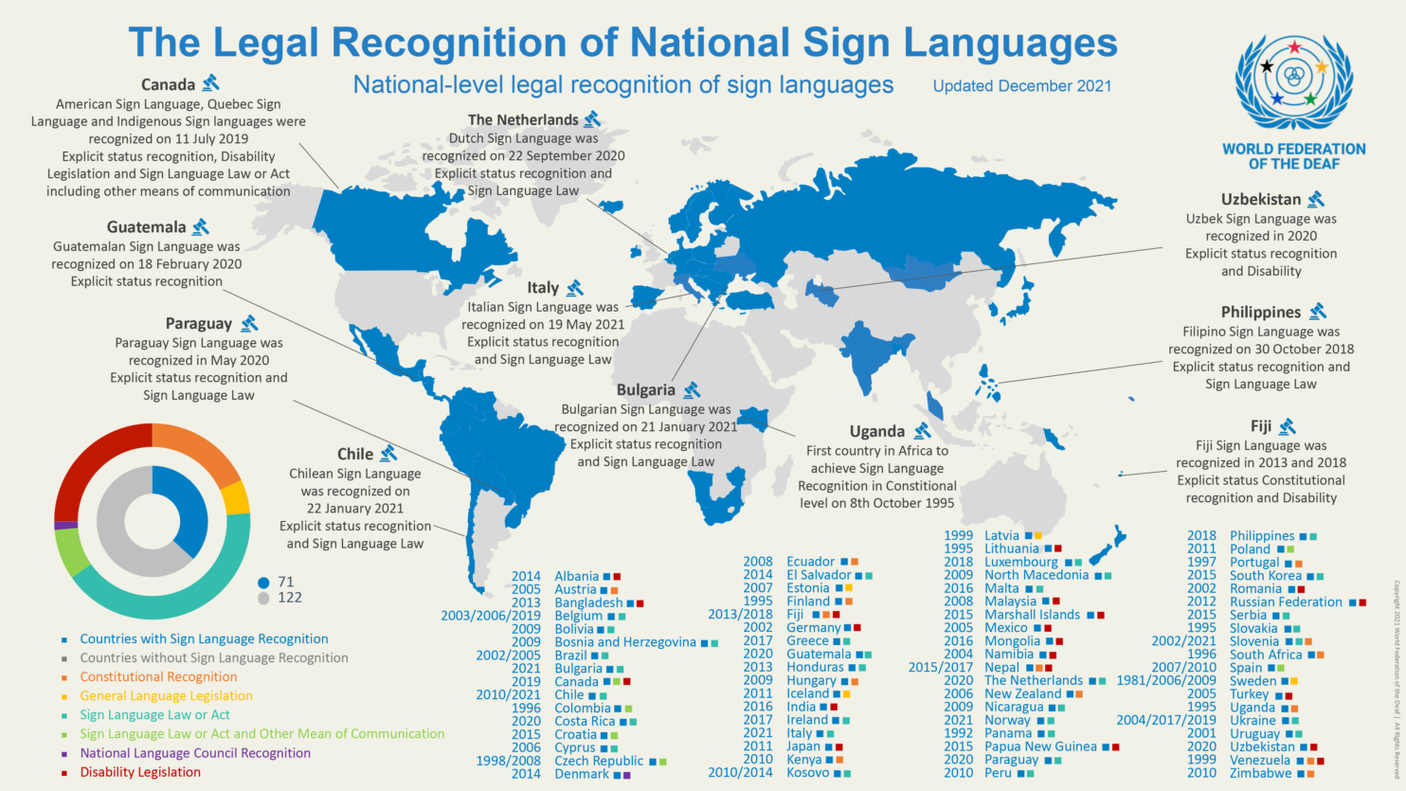
Thank you!
Pamela Molina
E-mail:
pamela.Molina@wfdeaf.org
Twitter: @PamelaMolinaT

