Slide 1
Representation and Rights in CODA
Rachel Kolb
Junior Fellow, Harvard Society of Fellows
rachelkolb@fas.harvard.edu

Slide 2
How does cinematic representation shape how we think about Deaf inclusion/rights?

Slide 3
How does cinematic representation shape how we think about Deaf inclusion/rights?
The world of the film: what are the ideas about Deaf lives and experiences that arise in the story?
The world beyond the film: how are various Deaf people involved in the filmmaking process itself?

Slide 4
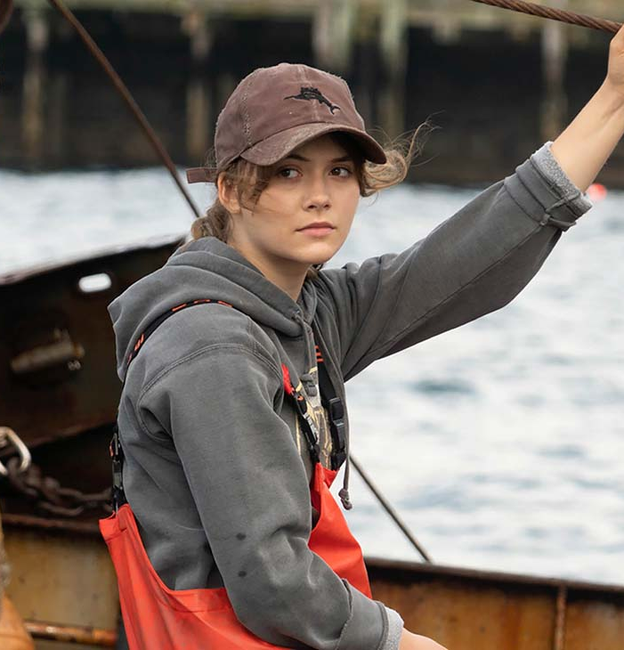
Film overview (no spoilers!)
Coming-of-age story of a CODA (Child of Deaf Adults) in a Deaf family in Gloucester, Massachusetts
Ruby explores the world of music while balancing kinship with her Deaf parents and brother, who operate a family fishing business
First film starring a predominantly Deaf cast

Slide 5
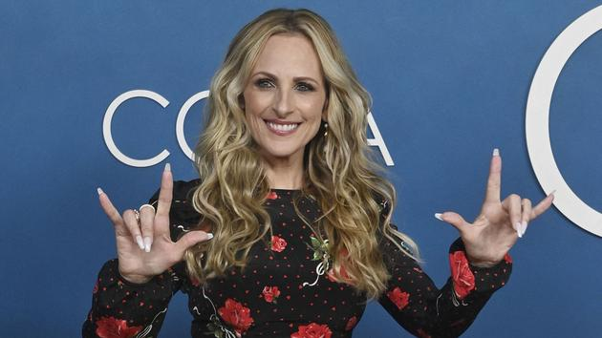
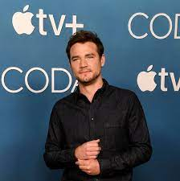
“Nothing about us without us”
All-Deaf leading cast (and ongoing discussions about Deaf/disabled casting)
Deaf collaboration in the filmmaking process
Further issues: authentic CODA casting, use of ASL in film
Awards recognition: Troy Kotsur nominated for Best Supporting Actor at the Oscars, recently won a Screen Actors’ Guild award

Slide 6
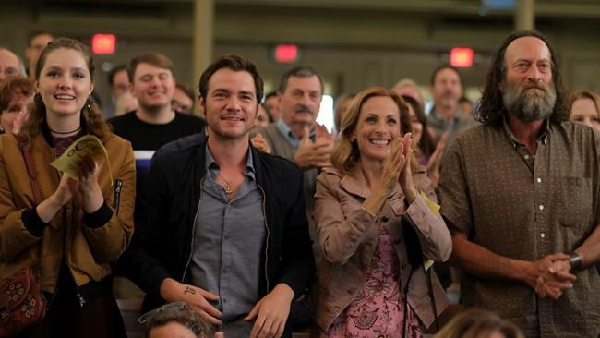
The World of CODA
Portrayal of rights and political consciousness
Odd accessibility vacuum
Establishing options beyond the system
Ongoing tropes about Deafness
Physicality, humor, isolation, sociality
Sound/music

Slide 8
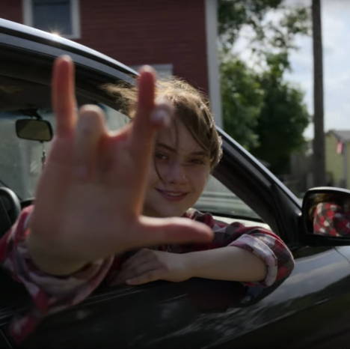
Where to?
More future stories of deafness? (other recent films: Sound of Metal, A Quiet Place, Wonderstruck)
Even more Deaf involvement in the filmmaking process
How can we tell more stories that include more different layers of deafness and beyond certain longstanding tropes?

Slide 9
Let’s discuss more in the Q&A!

